Slide 1
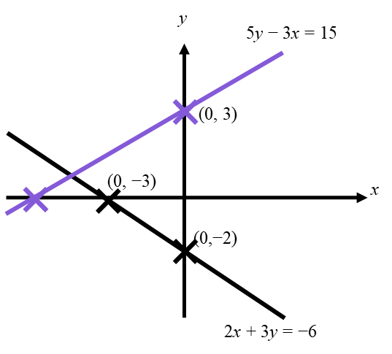
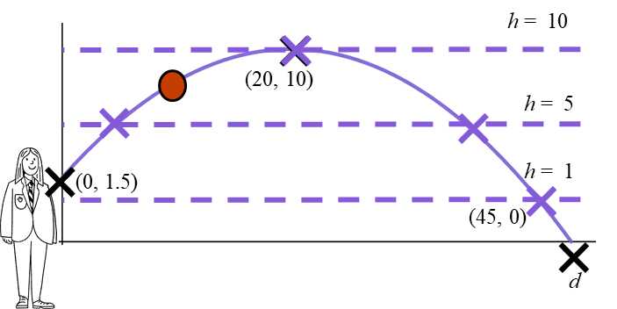
Problem solving with graphical representations
Task A: Using sketches to locate intersections
1) Sketch two lines for each equation to decide if the solution is positive or negative.
a) 15 − 9x = 6x + 31
y
b) 9 − 15x = 6x − 31
y
Intersection in the second quadrant, solution for x must be negative.
✖
(0, 31)
Intersection in the fourth quadrant, solution for x must be positive.
(0, 9)
✖
x
✖
(0, 15)
(0,−31)
✖
x
2) What equations does this sketch help us to solve and what can we see about the solution?
You might have written, “This sketch shows us that the intersection of the pair of simultaneous equations
5y − 3x = 15
2x + 3y = −6
lies in the second quadrant.
For the solution the x value must be negative and the y value positive.
3) Draw appropriate lines on this graph and identify intersections to answer these questions about Laura’s improving cricket throw.
a) How many times was the ball at a height of 5 m ?
Two intersections therefore twice.
b) How many times was the ball at a height of 1 m ?
One intersection therefore once.
c) How many times was the ball at a height of 10 m ?
One intersection therefore once.

Slide 2
Problem solving with graphical representations
Task B: Matching sketches to real-life models
1) Use these blank axes to draw three race events.
a) A short distance, fast race run at a constant speed.
c)
Short distance. Fast speed.
distance
b) A middle distance, medium pace race run at a constant speed.
b)
a)
Middle distance. Medium speed.
c) A long distance, slow run at a constant speed.
Longest time, longest distance. Slow speed.
time
2) This graph shows two animals running.
One is a human, one is a cheetah.
Identify which line represents which and explain how you know?
Full stop after exhausting their explosive energy.
distance
Cheetah
Human
Faster acceleration, faster top speed.
Slower animal but able to maintain a steady, constant speed for long periods.
time
This intersection is reassurance that you can outrun a Cheetah…
distance
Cheetah
✖
Human
Provided you last this long!
time
Mathematics in Education and Industry
v2.3

